Slide 1
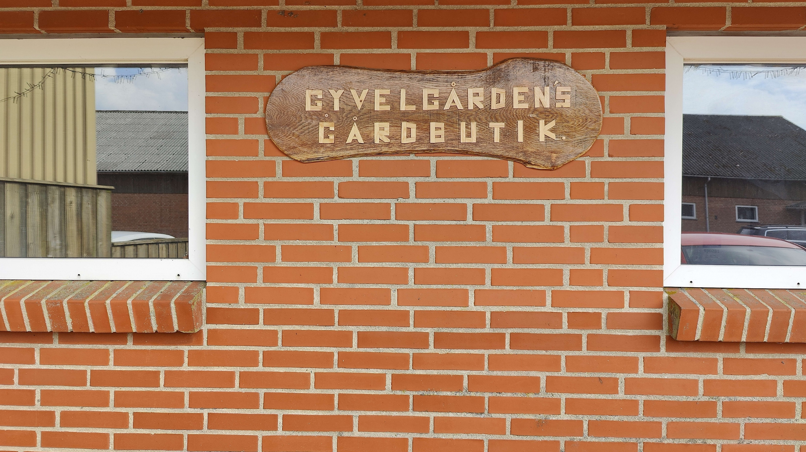
Gårdbutik
Lagerstyring system

Slide 2

Notes:
Img source https://git-scm.com/

Slide 3

Sikkerhed
Notes:
Power point stock image

Slide 4

Test
Unit test
Manuel
Notes:
Power point stock image

Slide 5


Selv valgt emne
Notes:
Bing ai dalle 2

Slide 6
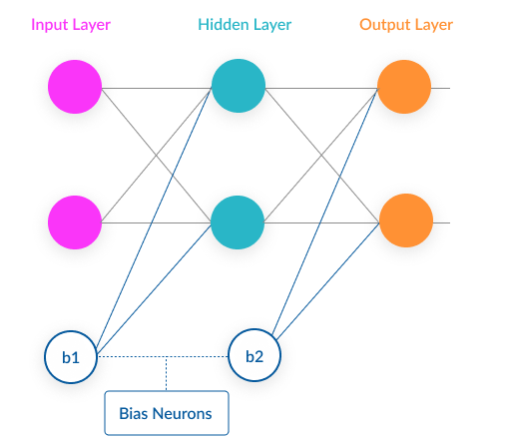
Neural Network
Neurons
Weight
Bias
Feed forward
Backpropagation

Slide 7
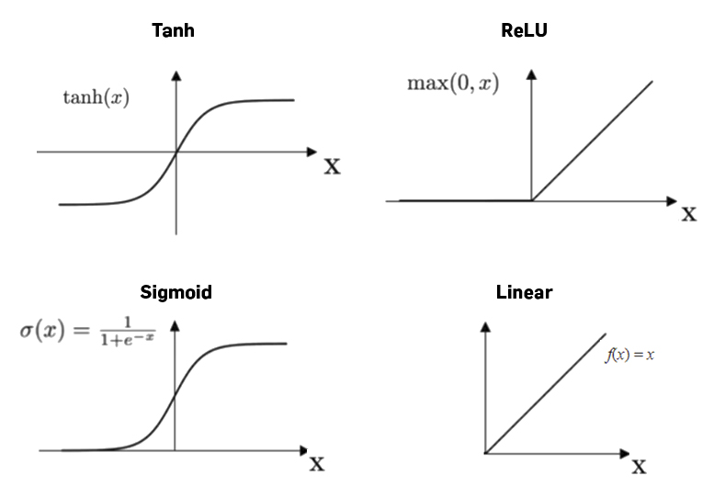
Activation functions
Notes:
https://machine-learning.paperspace.com/wiki/activation-function

Slide 8

Recurrent Neural Network
W2
Input
Output
W1
Input
Output
W1
W3
W3
W2
Input
Output
W1
W3
W2
Input
Output
W1
W3
Notes:
Powerpoint stock image

Slide 9
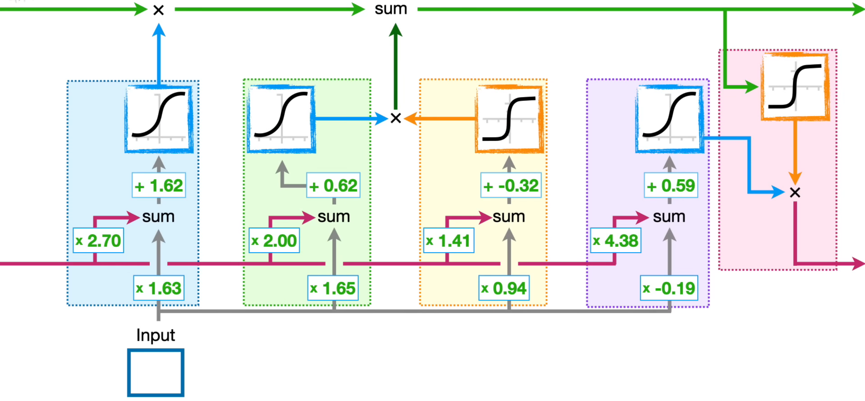
Long Short-Term Memory
Notes:
StatQuest https://www.youtube.com/watch?v=YCzL96nL7j0&t=1s

Slide 10
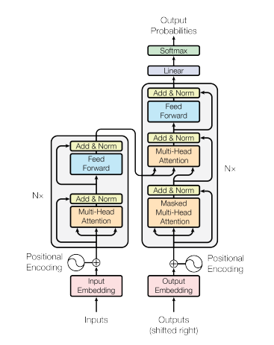
Transformer

